Slide 1
Planning for Capital Investments
Chapter 16
ACT 205 – Fundamentals of Accounting

Slide 2
ACT 205 – Fundamentals of Accounting
Chapter 1: Introduction to Financial Statements
Chapter 2: A Look at Financial Statements & Financial Statement Analysis
Chapter 3: The Accounting Information System
Chapter 4: Accrual Accounting Concepts
Exam 1
Chapter 5: Fraud, Internal Control, and Cash
Chapter 6: Recording and Analyzing Merchandising Transactions, A/R, Inventory
Chapter 7: Long-Lived Assets
Exam 2
Chapter 10: Managerial Accounting
Chapter 11: Cost-Volume-Profit
Chapter 13: Budgeting
Chapter 16: Planning for Capital Investments
Exam 3
Chapter 8: Liabilities and Equity
Final Exam

Slide 3
Part 1: Financial Accounting
Income Statement
Revenues
Less Expenses
= Net Income
Other Comprehensive Income
Statement of
Changes in Shareholders’
Equity
Common Stock
Retained
Earnings
Statement of
Cash Flows
Operating
Investing
Financing
Balance Sheet
Assets = Liabilities + Shareholders’ Equity
Cash Chp. 5
Accounts Receivable Chp. 6
Inventory Chp. 6
Long Lived Assets Chp. 7
Liabilities Chp. 8
Equity Chp. 8
The Accounting Process – Chapters 1,2,3,4

Slide 4
Managers’ Activities
Planning
Budgeting
13
Capital Investments
16
Cost Behavior
11
Controlling & Evaluating (Directing)
Special Decisions 12
Cost Concepts 10

Slide 5
Learning Objectives
To be able to use PV tables in Appendix E (Tables 3 and 4)
To use the Payback method to make capital investment decisions
To use the Net Present Value method to make capital investment decisions
To use the Annual Rate of Return method to make capital investment decisions

Slide 6
Terms
PV tables -
Payback -
Net Present Value -
Annual Rate of Return -

Slide 7
Planning for Capital Decisions
You have just won Publisher’s Clearing House $10,000,000. But it is awarded in $500,000/year for 20 years, interest rate of 6%. Would you take $7 million instead?
Do the Math! But How?
The Present value of one dollar to be collected in the future is less than one dollar.
Notes:
If at 10%, ordinary annuity $4,256,782 is worth that PV….so yes since 9 million is greater

Slide 8

CASH FLOW INFORMATION
What is all comes down to....
The value of all financial investments is determined by the value of cash flows received and paid

Slide 9
Background Information for this Chapter:
Time Value of Money Concept
This concept recognizes that the value of a dollar received in the future is less than today’s dollar.
The further into the future the receipt is expected to occur, the smaller its present value.

Slide 10
Present Value of $1 single Sum – Appendix E Table 3
Present Value Interest Rates convert future dollars to their Present Value (PV), need to know the interest rate
Investment + (.10 X Investment) = Future Cash Flows
$30,000 is invested 1 year at 10% = $33,000 in 1 year
So: discounting $33,000 back 1 year to the present
$33,000 x PVIF (Table 3 E-8) 0.90909 = $30,000
Notes:
Algebra can be cumbersome when an investment is expected to produce many cash inflows over a prolonged period of time.
Interest tables simplify the computations
Page 228 and 229 in book
So to calculate Publisher’s clearing house…
At 8%...
500,000 x 9.818147 = $4,909074 (rounded)..
So the PV of receiving $500,000 for 20 years, assuming 8% is a reasonable rate of return…and ignoring taxes…
Try at a lower rate of return
A business determines its desired rate of return by estimating its cost of capital.
A company must earn a rate at least equal to the rate it must pay stockholders and creditors….therefore the cost of capital is the company’s minimum desired rate of return.
Also called, Minimum rate of return, the cutoff rate, the discount rate, and the hurdle rate

Slide 11
Present Value for Annuities – Appendix E Table 4
An annuity is a series of equal periodic payments.
Let’s assume XYZ is going to receive $200,000 at the end of each of the next 4 years. The company uses an interest rate for present value calculations of 12%.
How do we determine the present value when faced with a series of payments?

Slide 12
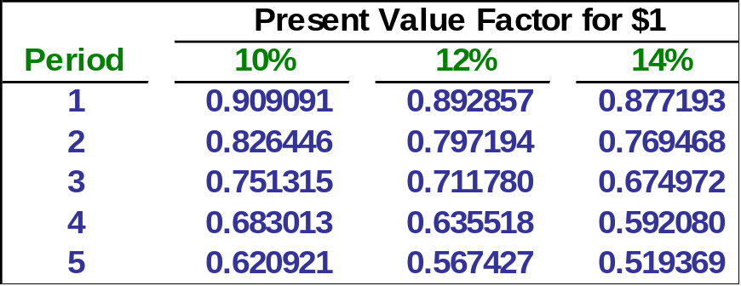
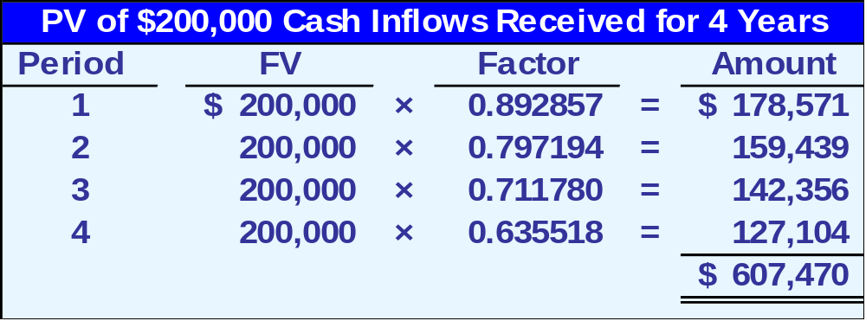
Present Value Tables for a $1 Single Sum vs. an Annuity
Table 3 – Appendix E
KEY: Investing $607,470 today at a 12% return is equivalent to receiving $200,000 each year for the next four years.
Go to Table 4 - find the interest factor for 12% and 4 years? = 3.03735
$200,000 * 3.03735 = ?

Slide 13
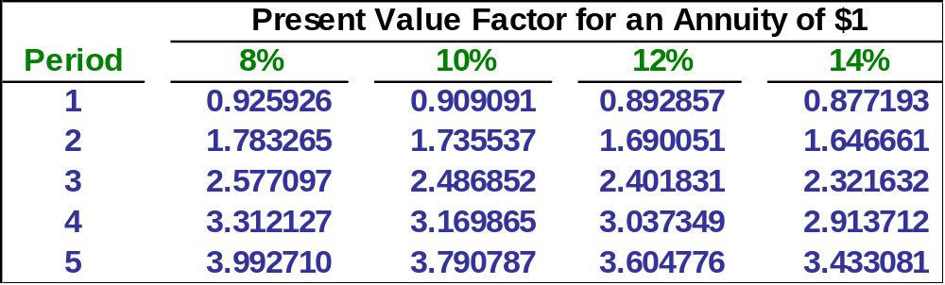
Present Value of an Annuity – See Appendix E Table 4
Ask yourself this Question:
What is an annuity? Answer: (1) equal payment amounts, (2) equal time intervals between payments, and (3) a constant rate of return.
$200,000 × 3.037349 = $607,470 (rounded)

Slide 14

A Planning methods Ignores Time Value of Money
Payback Method
This is a simple and easy approach to looking at the recovery of an investment.
Payback
period
Net cost of investment
Annual net cash inflows
=

Slide 15
Net Present Value Method Doesn’t IGNORE the Time Value of Money Concept
NPV = Present value of net cash flows
Less: Capital investment

Slide 16
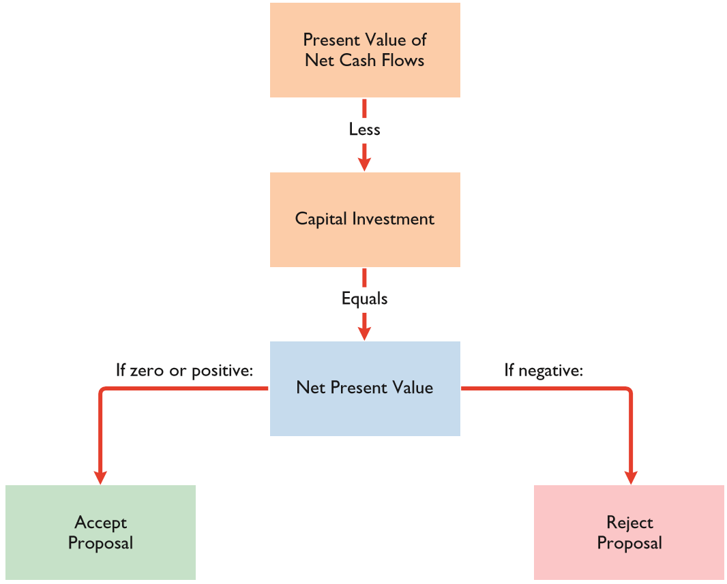
Net Present Value (NPV) method
In theory: A proposal is acceptable when NPV is zero or positive

Slide 17

XYZ can purchase projectors for $582,742. The company has a desired rate of return of 12%. The investment will provide a $200,000 cash inflow for the next four years.
Should EZ buy the projectors?
Notes:
PV of future cash flows: 607, 470
Cost of the investment (582,742)
NPV is 24, 728…so Yes
The NPV tells us that the investment will earn more than the desired rate of 12%

Slide 18
XYZ can purchase projectors for $582,742. The company has a desired rate of return of 12%. The investment will provide a $200,000 cash inflow for the next four years.
NPV = ($200,000 x (PVIF - .12, 4) Table 4) - $582,742
= ($200,000 x 3.03735) - $582,742
= $24,728
Answer: Accept (in theory)
Notes:
PV of future cash flows: 607, 470
Cost of the investment (582,742)
NPV is 24, 728…so Yes
The NPV tells us that the investment will earn more than the desired rate of 12%

Slide 19
To increase productivity, XYZ considers purchasing a new machine that costs $50,000. The machine is expected to provide annual net cash inflows of $12,500 for each of the next five years. XYZ desires a minimum annual rate of return of 10%.
Would you recommend that XYZ invest in the new machine?
Notes:
PV of cash inflows = $12,500 × 3.790787 = $47,385
PV of future Cash flows 47,385
Cost of the Investment 50,000
NPV would be (2,615) so NO!!!

Slide 20
To increase productivity, XYZ considers purchasing a new machine that costs $50,000. The machine is expected to provide annual net cash inflows of $12,500 for each of the next five years. XYZ desires a minimum annual rate of return of 10%.
Would you recommend that XYZ invest in the new machine?
NPV = $12,500 x (PVIF Table 4, .10 and 5 years) - $50,000
NPV = ($12,500 x 3.79079) - $50,000
NPV = ($2,615)
Answer: Reject
Notes:
PV of cash inflows = $12,500 × 3.790787 = $47,385
PV of future Cash flows 47,385
Cost of the Investment 50,000
NPV would be (2,615) so NO!!!

Slide 21
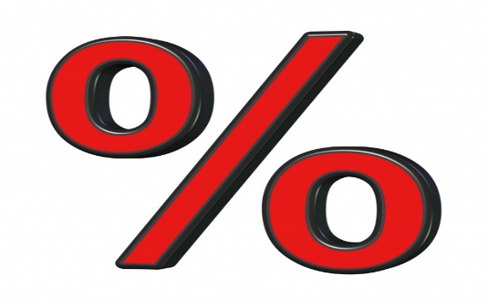
Annual Rate of Return (ARR)
Expected Annual Net Income /Average Investment = Annual Rate of Return
(Original investment + Salvage Value)/ 2 = Average Investment
IF
ARR > Required Rate of Return
Accept!

Slide 22
Problems
I do: 16P-1, 16E-1
You do: 16p-2, 16E-2

